Slide 1

FLOOD MONITORING
AND EARLY WARNING

Slide 2
INTRODUCTION
Moreover, the increase of water level without any controls when flood happens can also troubles drivers to pass through the road . In most cases, flood water level rises faster and less time is available for the people to evacuate . The alerts for early flood warning system usually needed for the respective organizations and authorities; this is because it will take time for them to reach as water rises quickly in most cases .

Slide 3
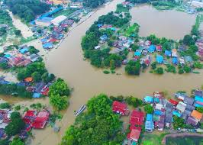
PROBLEM STATEMENT
Effective flood management is crucial for safeguarding lives, property, and the environment in flood-prone areas.
However, there are numerous challenges associated with flood management that require attention
. Predictive accuracy
. Environmental Impact
. Policy and Governance
Solving these challenges require interdisciplinary efforts involving meteorologists, hydrologists, engineers, policymakers and communities to create a comprehensive flood management strategy that minimizes risks and ensures the safety and well-being of affected populations.

Slide 4
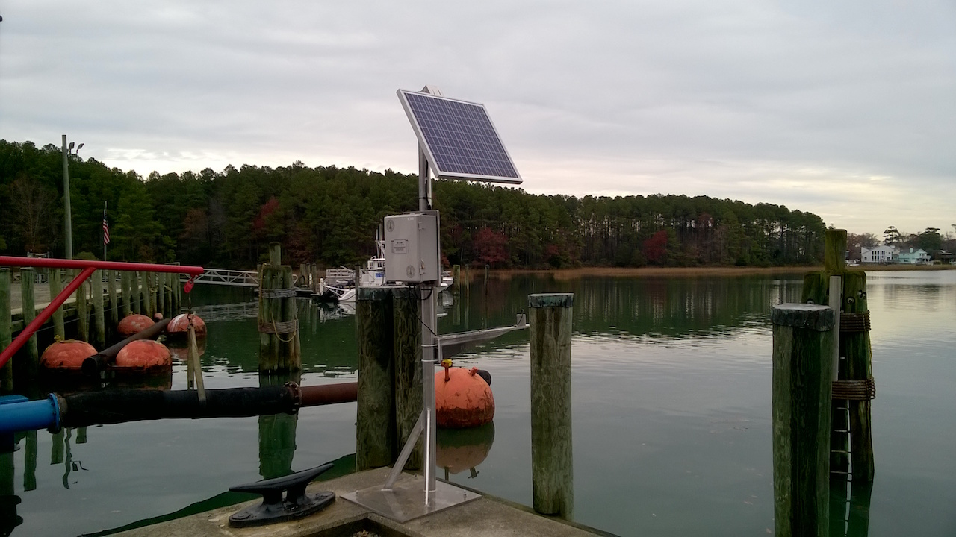
FLOOD MONITORING
.Sensors placed in rivers and streams to monitor water levels.
.Transmit data on rivers stage and flow rates to assess flood risk.
.Instruments for measuring temperature, humidity, rainfall, wind speed, and direction.
.Collect real-time weather data to predict rainfall and weather patterns that can lead to flood..

Slide 5
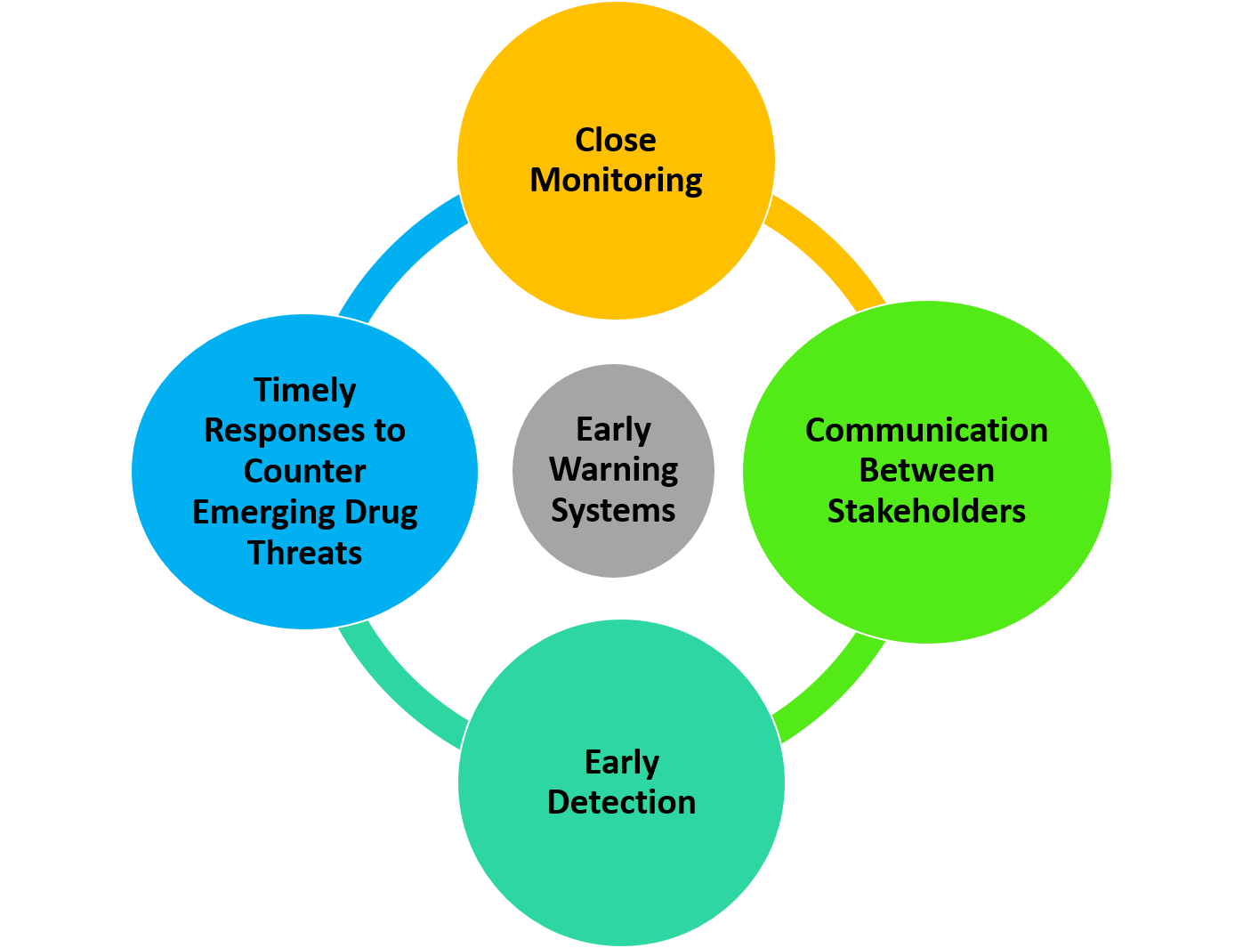
EARLY WARNING SYSTEM
An early warning system is a warning system that can be implemented as a chain of information communication systems and comprises sensors, event detection and decision subsystems for early identification of hazards. They work together to forecast and signal disturbances that adversely affect the stability of the physical world, providing time for the response system to prepare for the adverse event and to minimize its impact.

Slide 6

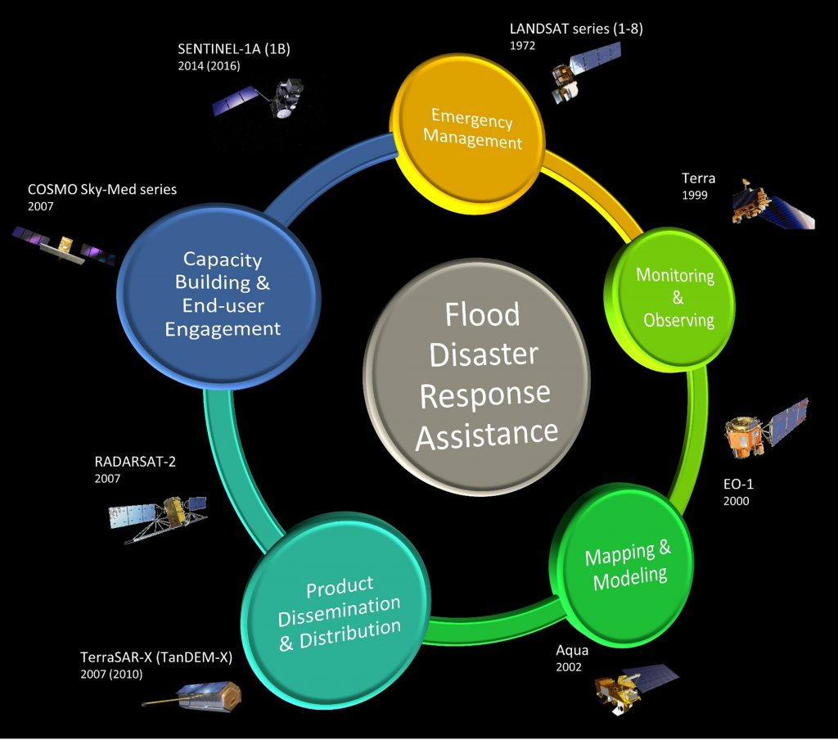
METHODOLOGY

Slide 7
PROBLEM SOLUTION
Hardware and technology : Invest in advanced technology such as radar, remote sensing, and early warning system.
Ensure proper maintenance of hardware components.
Data Integration : Invest is integration data platform and geographic information systems (GIS) for better data management and sharing agencies.

Slide 8
CONCLUSION
conclusion, this product has been successfully applied by using the ultrasonic sensor to detect water levels and send the data to the mobile phone application through IoT. The activation of GPS Neo - 6M to connect to the satellite allows the coordinates of a specific location to be transmitted thus providing accurate flooding locations that can be monitored through the mobile application. Next, the nodeMCU is used to control the system’s water level features (safe level, warning level, and critical level).

Slide 9
THANK YOU

